Slide 1
Text Analysis of congress member tweets

Slide 2
Content
Question to answer / Hypotheses / Approach
Discuss Technical Challenge
Detail: Entity Relationship Diagram(ERD)
Initial Findings
Deeper Analysis
Hypothesis Results

Slide 3
Dataset:
Tweets data set from congress member congress member twitter dataset
(Provided by Coursera)
Question to answer:
Is there a shift of keyword in the tweets across time (months, quarter, (election) year and is there a pattern behind it.
What is the hot topic trend across these period ?

Slide 4
Initial Hypotheses:
The average tweets activities have increased over the years
There is a significant hot topics difference between election years and non election years

Slide 5
Dataset:
tweets data set from congress member congress member twitter dataset
Initial Hypotheses:
The average tweets activities have increased over the years
There is a significant change of tweets topic’s trend between election years and non election years

Slide 6
Approach:
Using TFIDF to
Identifying approach to quantity similarity for tweet comparison

Slide 7
Technical Challenge:
Processing and cleaning large amount of tweets
Identifying approach to quantity similarity for tweet comparison

Slide 8
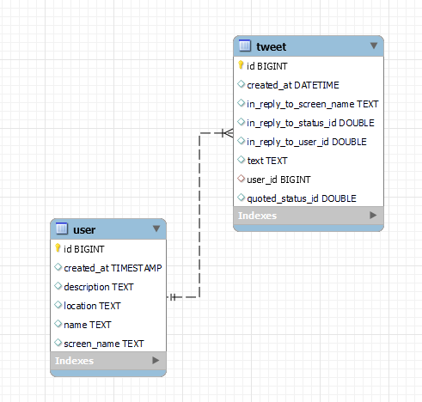
Detail: Entity Relationship Diagram(ERD)

Slide 9
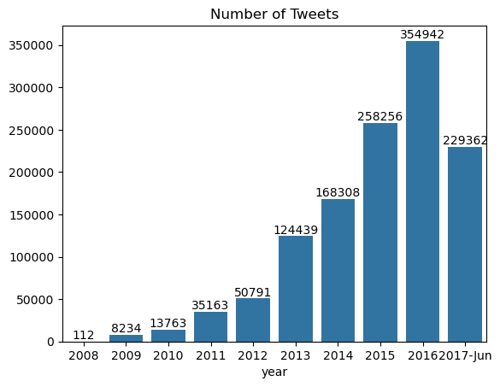
Descriptive Data Summary:
Findings:
Tweets activities from congress member have been increasing from 2008 to 2017

Slide 10
Descriptive Data Summary:
Top hashtag and mention
Top mention and reply
Top hashtag words
mention | counts
@potus | 8411
@housegop | 5342
@realdonaldtrump | 3687
@foxnews | 2697
@whitehouse | 2511
@housedemocrats | 2368
@housegop: | 2156
@speakerboehner: | 2120
@speakerryan: | 2098
@housecommerce: | 2060
@gopoversight | 1939
@msnbc | 1873
@speakerryan | 1803
@oversightdems: | 1708
@waysandmeansgop: | 1569
@houseappropsgop: | 1541
@nancypelosi: | 1520
@epa | 1520
@cnn | 1519
@speakerboehner | 1501
hashtag | counts
#obamacare | 10309
#tcot | 8677
#sotu | 5147
#utpol | 4794
#mepolitics | 4648
#aca | 4604
#scotus | 4573
#gop | 4357
#veterans | 4208
#smallbiz | 3965
#jobs | 3835
#trumpcare | 3578
#4jobs | 3087
#tbt | 2993
#irs | 2816
#ia03 | 2682
#immigration | 2630
#ff | 2491
#lgbt | 2051
#keystonexl | 2021

Slide 11
Deeper Analysis
Top 5 Topic Cluster
Topic Cluster 1: Women, Family
Keyword: talk,must,protect,commun,help,work,women,honor,support,us,discuss,rt,join,famili,amp
Topic Cluster 2:Asking for support
Keyword: time,agre,state,day,new,watch,htt,congressman,housegop,live,support,say,rep,us,rt
Topic Cluster 3: Election Campaign / Voting related
Keyword:nation,visit,hous,live,meet,year,discuss,pm,offic,hear,vote,join,day,honor,today
Topic Cluster 4:Bill , job and health care
Keyword:care,new,senat,health,support,need,act,pass,help,vote,job,american,work,hous,bill
Topic Cluster 5: Student and School
Keyword : commun,state,talk,school,news,student,time,morn,discuss,work,visit,day,see,meet,great

Slide 12
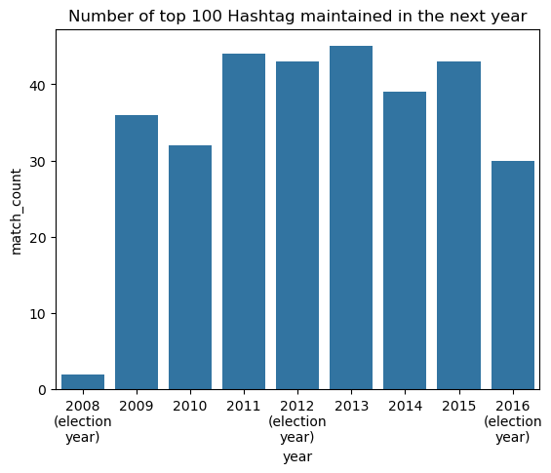
Deeper Analysis
Change of Trend by Hashtag
Steady rate of change of trend shown in this graph which disagree with the initial Hypotheses that there is a significant hot topics difference between election years and non election years.
The data in 2008 is low due to there are only 6 hashtag in the dataset

Slide 13
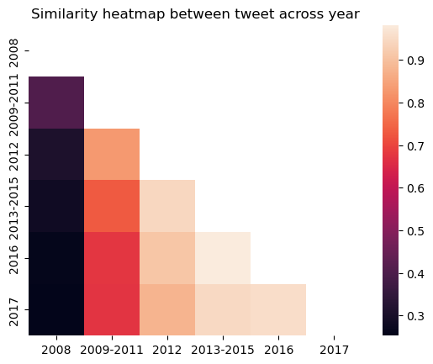
Deeper Analysis
Similarity Analysis
Similarity result the similarity tend to increase when
The years in comparison are closer
The years in comparison are later
One potential factor of this result would the number of tweets count difference.
The large size of tweets in a year may dilute the weight of each terms which causing the difference when calculating the similarity with tweets in a year that have a much smaller number of tweets

Slide 14
Hypotheses Result:
Hot business related Hashtag includes fuel, healthcare, jobs , small business.
No significant prove found for change of tweet trend related to whether is it election year or not
Top 5 cluster :
Woman and Family
Congress member asking for support
Election Campaign / Voting related
Bill , job and health care
Student and School
Additional Findings:
Similarity in recent year is high , similarity score >0.9 when comparing tweets of 2017 to 2016 and 2015
Recommendation:
Significant change of lobbying activities in election year may not be required as the there is no sign of change in topic trend from tweets during election year.

Slide 15
Thank you

